Slide 1
Chapter 2 Getting Connected
Gandeva Bayu Satrya (GBS)
gbs@ittelkom.ac.id
gandeva.bayu.s@gmail.com
TELKOM ENGINEERING SCHOOL
Telkom University

Slide 2
Agenda
Chapter 2. Getting Connected
2.1 Connecting
2.2 Encoding
2.3 Framing
2.4 Error Detection
2.5 Reliable
2.6 Ethernet
2.7. Wireless

Slide 3
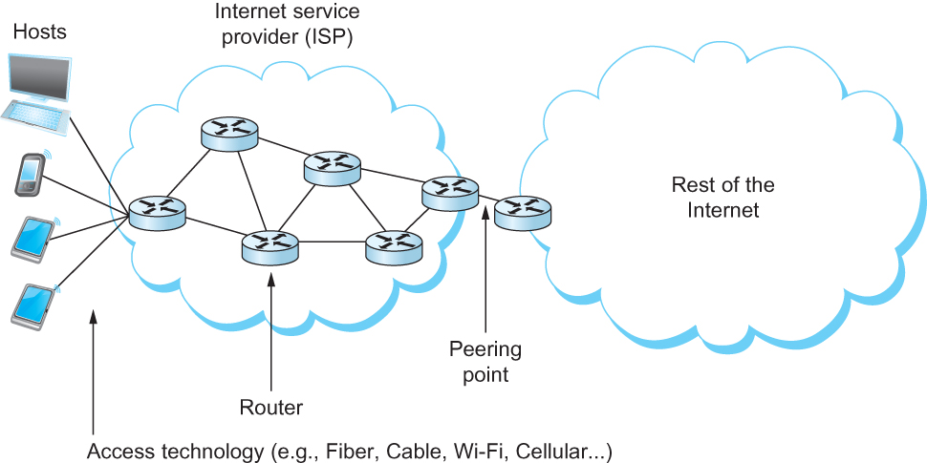
Connecting
An end-user’s view of the Internet

Slide 4
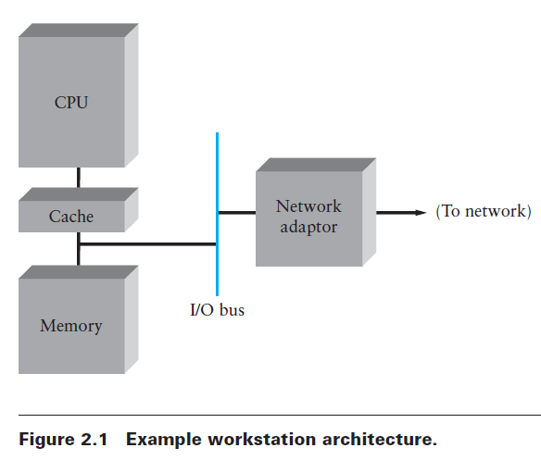
Nodes
Nodes are often general-purpose computers, like a desktop workstation, a multiprocessor, or a PC.
Or it can be a router, switch, ect
Each node connects to the network via a network adaptor

Slide 5
Shannon-Hartley Theorem
Signal Processing and Information Theory,
studying everything from how signals degrade over distance to how much data a given signal can effectively carry.
C = B log₂ (1+S/N)
Where B = 3300 – 300 = 3000Hz, S is the signal power, N the average noise.
The signal to noise ratio (S/N) is measured in decibels is related to dB = 10 x log₁₀(S/N). If there is 30dB of noise then S/N = 1000.
Now C = 3000 x log₂(1001) = 30kbps.

Slide 6
Links
Network links are implemented on a variety of different physical media. Whatever the physical medium, it is used to propagate signals
One way to characterize links, then, is by the medium they use
Typically copper wire in some form (as in Digital Subscriber Line (DSL) and coaxial cable),
Optical fiber (as in both commercial fiber-to-the home services and many long-distance links in the Internet’s backbone), or
Air/free space (for wireless links)

Slide 7
Links
Another important link characteristic is the frequency
Measured in hertz, with which the electromagnetic waves oscillate
Distance between the adjacent pair of maxima or minima of a wave measured in meters is called wavelength
Speed of light divided by frequency gives the wavelength.
Frequency on a copper cable range from 300Hz to 3300Hz; Wavelength for 300Hz wave through copper is speed of light on a copper / frequency
2/3 x 3 x 10⁸ /300 = 667 x 10³ meters.
Placing binary data on a signal is called encoding.
Modulation involves modifying the signals in terms of their frequency, amplitude, and phase.

Slide 8
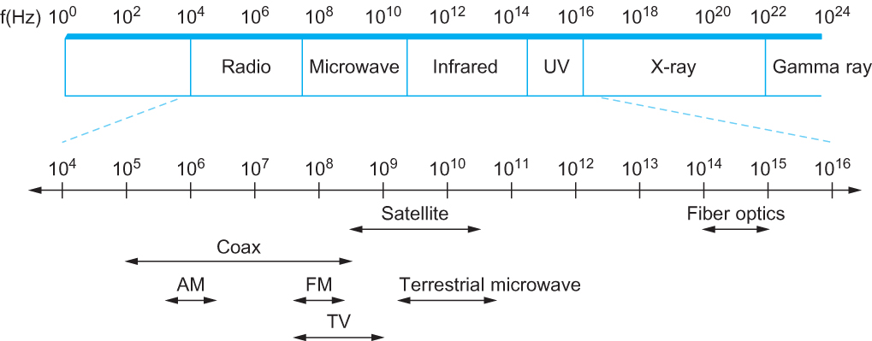
Links
Electromagnetic spectrum

Slide 9
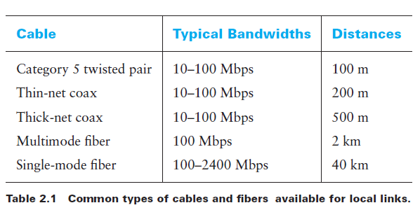
Links- Cables

Slide 10
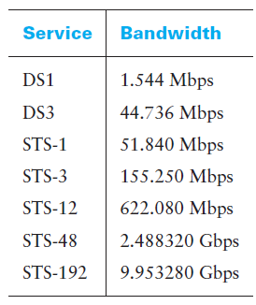
Links-Leased Line

Slide 11
Agenda
Chapter 2. Getting Connected
2.1 Connecting
2.2 Encoding
2.3 Framing
2.4 Error Detection
2.5 Reliable
2.6 Ethernet
2.7. Wireless

Slide 12
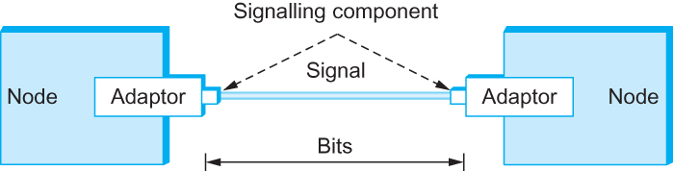
Encoding
Placing binary data on a signal is called encoding.
Signals travel between signaling components; bits flow between adaptors

Slide 13
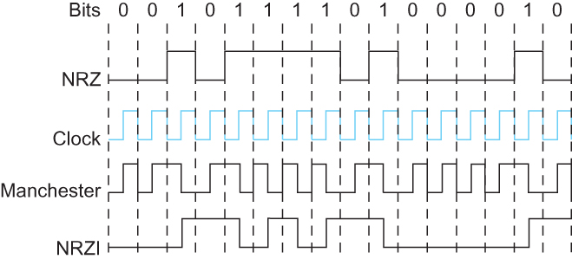
Encoding

Slide 14
Task 1 : no.1
Jelaskan kelebihan dan kekurangan dari Encoding
NRZ
Clock
Manchester
NRZI
4B/5B
Tulis Tangan
Batas akhir Kamis 26/02/15
16.00pm, Ruang Kubikal Dosen

Slide 15
Agenda
Chapter 2. Getting Connected
2.1 Connecting
2.2 Encoding
2.3 Framing
2.4 Error Detection
2.5 Reliable
2.6 Ethernet
2.7. Wireless

Slide 16
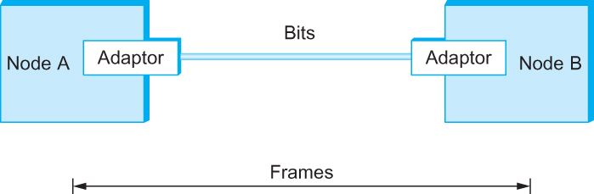
Framing
We are focusing on packet-switched networks, which means that blocks of data (called frames at this level), not bit streams, are exchanged between nodes.
It is the network adaptor that enables the nodes to exchange frames.
Bits flow between adaptors, frames between hosts

Slide 17
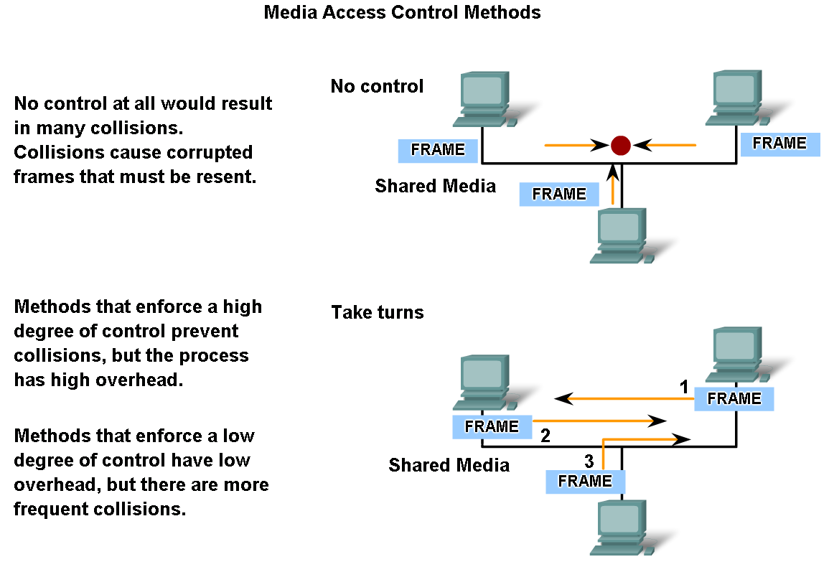
Framing

Slide 18
Framing
There are several ways to address the framing problem. This section uses several different protocols to illustrate the various points in the design space.
Byte-Oriented Protocols (BISYNC, PPP, DDCMP)
Bit-Oriented Protocols (HDLC)
Clock-Based Framing (SONET)

Slide 19



Byte Oriented Protocols
BISYNC Frame Format (SYN,STX, ETX)
PPP Frame Format (Flags, Checksum)
DDCMP Frame Format (Count)

Slide 20

Bit Oriented Protocols
HDLC : High Level Data Link Control
Beginning and Ending Sequences 0 1 1 1 1 1 1 0

Slide 21
Clock Based Framing
Synchronous Optical Network (SONET)
SONET was ﬁrst proposed by Bell Communications Research (Bellcore), and then developed under the American National Standards Institute (ANSI) for digital transmission over optical ﬁber; it has since been adopted by the ITU-T.
SONET has been for many years the dominant standard for long-distance transmission of data over optical networks.
Notes:
which is known as STS-1 and runs at 51.84 Mbps.
It is arranged as 9 rows of 90 bytes each, and the ﬁrst 3 bytes of each row are overhead, with the rest being
available for data that is being transmitted over the link. The ﬁrst 2 bytes of the frame contain a special bit pattern, and it is these bytes that enable the receiver to determine where the frame starts.

Slide 22
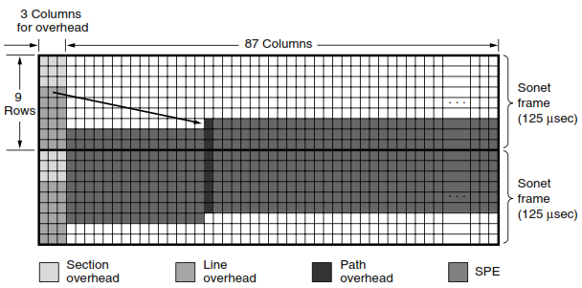
Clock Based Framing
Synchronous Optical Network (SONET)
Tanenbaum , 2011.
Notes:
STS-1 (Synchronous Transport Signal-1).
SPE (Synchronous Payload Envelope)

Slide 23
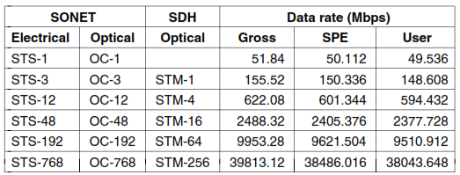
SONET and SDH
Tanenbaum , 2011.
Notes:
SDH (Synchronous Digital Hierarchy)
In 1985, Bellcore, the RBOC’s research arm, began working on a standard, called SONET (Synchronous Optical NETwork).
Later, ITU joined the effort, which resulted in a SONET standard and a set of parallel ITU recommendations (G.707, G.708, and G.709) in 1989. The ITU recommendations are called SDH (Synchronous Digital Hierarchy) but differ from SONET only in minor ways.

Slide 24
Agenda
Chapter 2. Getting Connected
2.1 Connecting
2.2 Encoding
2.3 Framing
2.4 Error Detection
2.5 Reliable
2.6 Ethernet
2.7. Wireless

Slide 25
Error Detection
Bit errors are introduced into frames
Because of electrical interference and thermal noises
Detecting Error
Correction Error
Two approaches when the recipient detects an error
Notify the sender that the message was corrupted, so the sender can send again.
If the error is rare, then the retransmitted message will be error-free
Using some error correct detection and correction algorithm, the receiver reconstructs the message

Slide 26
Error Detection
Common technique for detecting transmission error
CRC (Cyclic Redundancy Check)
Used in HDLC, DDCMP, CSMA/CD, Token Ring
Other approaches
Two Dimensional Parity (BISYNC)
Checksum (IP)

Slide 27
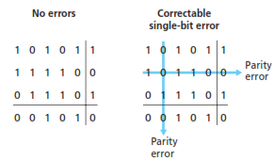
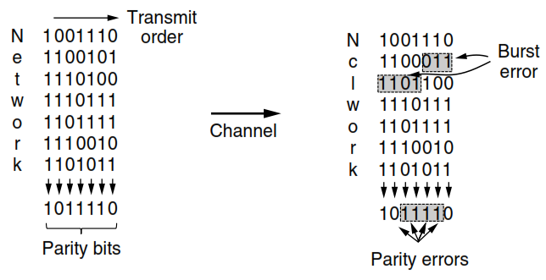
Two Dimensional Parity
Kurose, 2013.
Tanenbaum , 2011.

Slide 28
Internet Checksum
The idea behind the Internet checksum is very simple—you add up all the words that are transmitted and then transmit the result of that sum.
The result is the checksum. The receiver performs the same calculation on the received data and compares the result with the received checksum.
One example of a checksum is the 16-bit Internet checksum used on all Internet packets as part of the IP protocol (Braden et al., 1988).

Slide 29
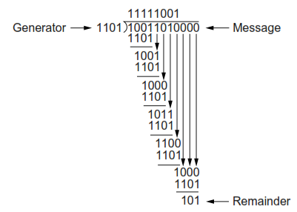
CRC (Cyclic Redundancy Check)
CRC, also known as a Polynomial Code.
M(x) = X⁷+X⁴+X³+X and G(x) = X³+X²+1
So, T(x) = 10011010101
Tanenbaum , 2011.

Slide 30
Agenda
Chapter 2. Getting Connected
2.1 Connecting
2.2 Encoding
2.3 Framing
2.4 Error Detection
2.5 Reliable
2.6 Ethernet
2.7. Wireless

Slide 31
Reliable Transmission
CRC is used to detect errors.
Some error codes are strong enough to correct errors.
The overhead is typically too high.
Corrupt frames must be discarded.
A link-level protocol that wants to deliver frames reliably must recover from these discarded frames.
This is accomplished using a combination of two fundamental mechanisms
Acknowledgements and Timeouts
The general strategy of using acknowledgments and timeouts to implement reliable delivery is sometimes called Automatic Repeat reQuest (ARQ).

Slide 32
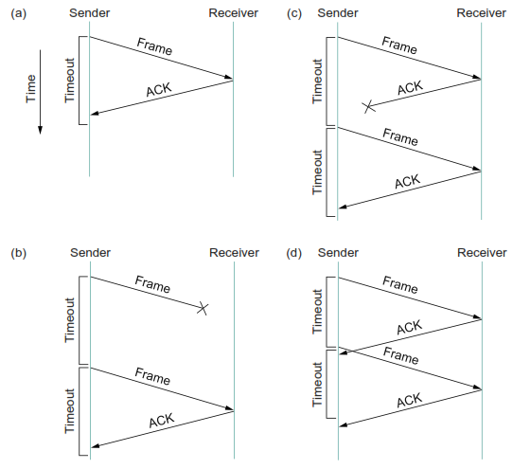
1. STOP and WAIT
Notes:
Timeline showing four different scenarios for the stop-and-wait algorithm. (a) The ACK is received before
the timer expires; (b) the original frame is lost; (c) the ACK is lost; (d) the timeout fires too soon.

Slide 33
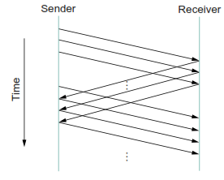
2. SLIDING WINDOWS

Slide 34
3. Concurrent Logical Channels
The data link protocol used in the ARPANET provides an interesting alternative to the sliding window protocol, in that it is able to keep the pipe full while still using the simple stop-and-wait algorithm.
The idea underlying the ARPANET protocol, which we refer to as concurrent logical channels, is to multiplex several logical channels onto a single point-to-point link and to run the stop-and-wait algorithm on each of these logical channels.

Slide 35
Agenda
Chapter 2. Getting Connected
2.1 Connecting
2.2 Encoding
2.3 Framing
2.4 Error Detection
2.5 Reliable
2.6 Ethernet
2.7. Wireless

Slide 36
Ethernet
Developed in the mid-1970s by researchers at the Xerox Palo Alto Research Centers (PARC).
Uses CSMA/CD technology
Carrier Sense Multiple Access with Collision Detection.
A set of nodes send and receive frames over a shared link.
Carrier sense means that all nodes can distinguish between an idle and a busy link.
Collision detection means that a node listens as it transmits and can therefore detect when a frame it is transmitting has collided with a frame transmitted by another node.

Slide 37
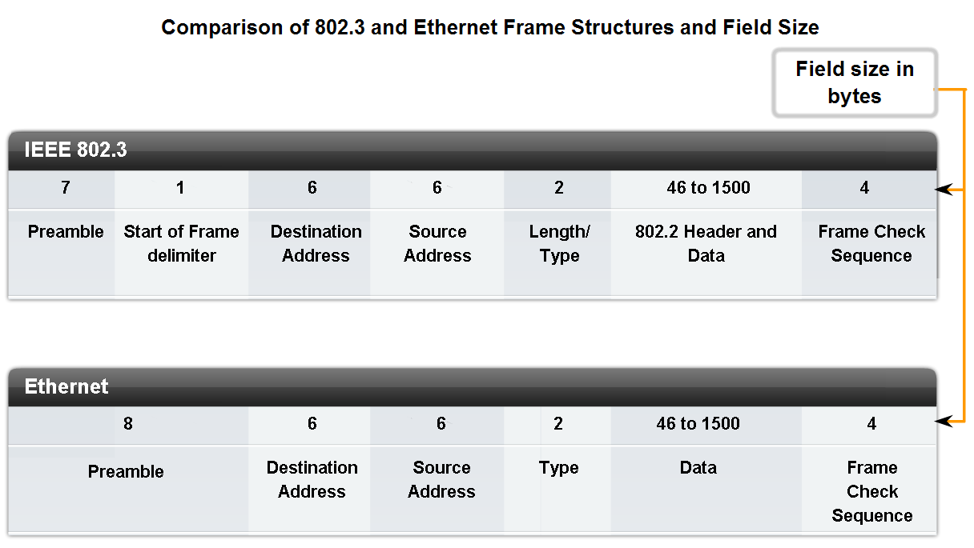
Ethernet
Uses ALOHA (packet radio network) as the root protocol
DEC and Intel joined Xerox to define a 10-Mbps Ethernet standard in 1978.
This standard formed the basis for IEEE standard 802.3

Slide 38
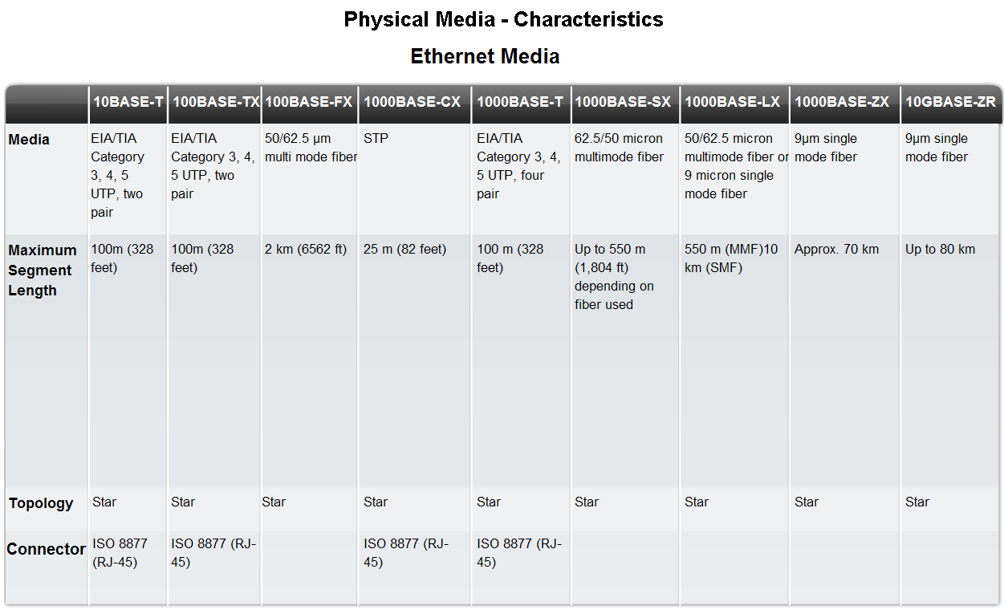
Ethernet

Slide 39
Ethernet
Any signal placed on the Ethernet by a host is broadcast over the entire network
Signal is propagated in both directions.
Repeaters forward the signal on all outgoing segments.
Terminators attached to the end of each segment absorb the signal.
Ethernet uses Manchester encoding scheme.

Slide 40
Ethernet Address
Each host on an Ethernet (in fact, every Ethernet host in the world) has a unique Ethernet Address.
The address belongs to the adaptor, not the host.
It is usually burnt into ROM.
The first three octets (in transmission order) identify the organization that issued the identifier and are known as the Organizationally Unique Identifier (OUI) and The Last three octets identify Network Interface Controller (NIC)

Slide 41
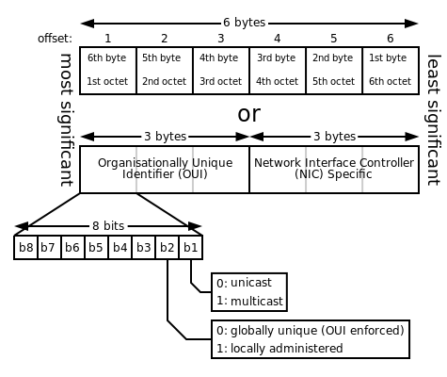

Ethernet Address
Wikipedia, 2013.
Example :
Ethernet adapter Local Area Connection:
Media State . . . . . . . . . . ……….. : Media disconnected
Description . . . . . . . . . . ………… : Intel(R) 82579LM Gigabit Network Connection
Physical Address. . . . . . . . …….. : 00-1E-37-25-A6-9B
DHCP Enabled. . . . . . . . . . . …… : No
Autoconfiguration Enabled . . . . .. : Yes

Slide 42
Agenda
Chapter 2. Getting Connected
2.1 Connecting
2.2 Encoding
2.3 Framing
2.4 Error Detection
2.5 Reliable
2.6 Ethernet
2.7. Wireless

Slide 43
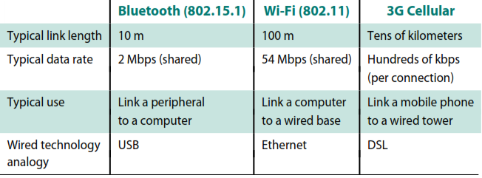
Wireless Technology

Slide 44
Task 1 : no.2
Jelaskan karakteristik dari masing-masing jenis WiFi yang anda ketahui hingga teknologi paling terkini serta perbedaannya!
(hint : 802.11a,… … … … …)
Tulis Tangan
Batas akhir kamis 26/02/15
16.00pm, Ruang Kubikal Dosen

Slide 45
Bibliography
Kurose, J.F., and Ross, K.W., Computer Networking : A Top-Down Approach Sixth Edition, Pearson Education, Inc. USA, 2013.
Peterson, L.L., and Davie, B.S., Computer Networks: A Systems Approach Fifth Edition, Morgan Kaufmann, Burlington USA, 2012.
Tanenbaum, A.S., and Wetherall, D.J., Computer Networks Fifth Edition, Pearson Education, Inc., Boston USA, 2011.
Lammle T., Cisco Certified Network Associate : Study Guide Fifth Edition, Sybex, Inc. USA, 2005.

Slide 46
THANK YOU
Gandeva Bayu Satrya (GBS)
gbs@ittelkom.ac.id
gandeva.bayu.s@gmail.com
TELKOM ENGINEERING SCHOOL
Telkom University

